Slide 1

Preventing and Treating Advanced HIV Disease

Slide 2
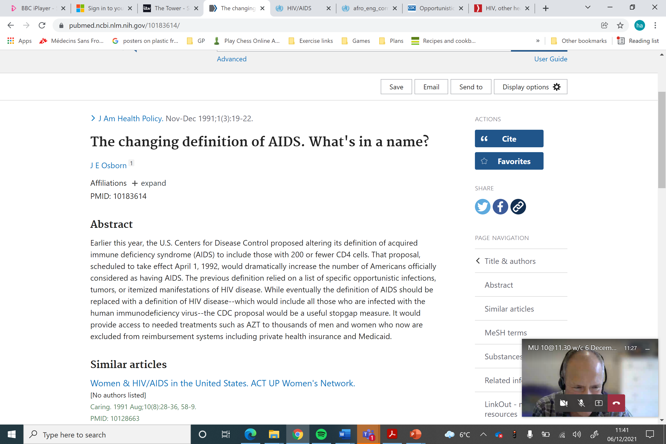
AIDS: What’s in a name? Over the years the case definition changed
WHO 2007:
Used term advanced HIV – was more than AIDS definition
AIDS : Stage 4 condition and or CD4 < 200

Slide 3
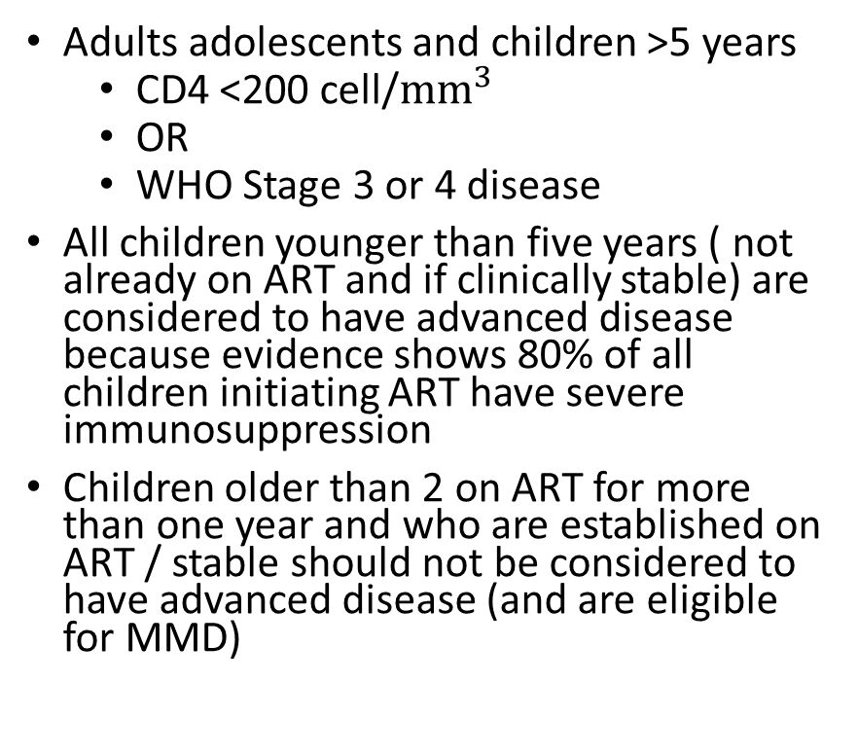
We need to know the WHO Definition of Advanced HIV disease(2021) so we are clear who is eligible for the AHD package
Adults adolescents and children >5 years
CD4 <200 cell/${mm}^{3}$
OR
WHO Stage 3 or 4 disease
All children younger than five years ( not already on ART and if clinically stable) are considered to have advanced disease because evidence shows 80% of all children initiating ART have severe immunosuppression
Children older than 2 on ART for more than one year and who are established on ART / stable should not be considered to have advanced disease (and are eligible for MMD)

Slide 4
Has staging been forgotten?
Need to remember how to stage to know who is eligible for the AHD package

Slide 5
Is advanced HIV disease getting less common ?
2012-2016 % <200 remained pretty constant
PHIA data 10-20% < 200 ( surveys 2015-2017)

Slide 6
What is the AHD package? 1. Screening and diagnosis
Entry point staging and CD4
TB :
screening at any CD4 – standard package
LAM: CD4 < 200 inpatient ; < 100 outpatient; or any CD4 with symptoms or seriously unwell
Cryptococcal Meningitis
CRAG : CD4 < 100 ( consider for < 200)
Not for children

Slide 7
What is the AHD package? 2. Prophylaxis and pre-emptive treatment
Cotrimoxazole
TB preventive therapy
Fluconazole if CrAG positive

Slide 8
What is the AHD package? 3. Rapid ART Initiation & 4. Adapted adherence support
Rapid : within 7 days – offer of same day
Only reason for delay cryptococcal or TB meningitis

Slide 9
Cryptococcal Meningitis
Top 10 countries of interest
South Africa
India
Mozambique
Indonesia
Kenya
Tanzania
DRC
Thailand
Zambia
Ethiopia

Slide 10


Slide 11
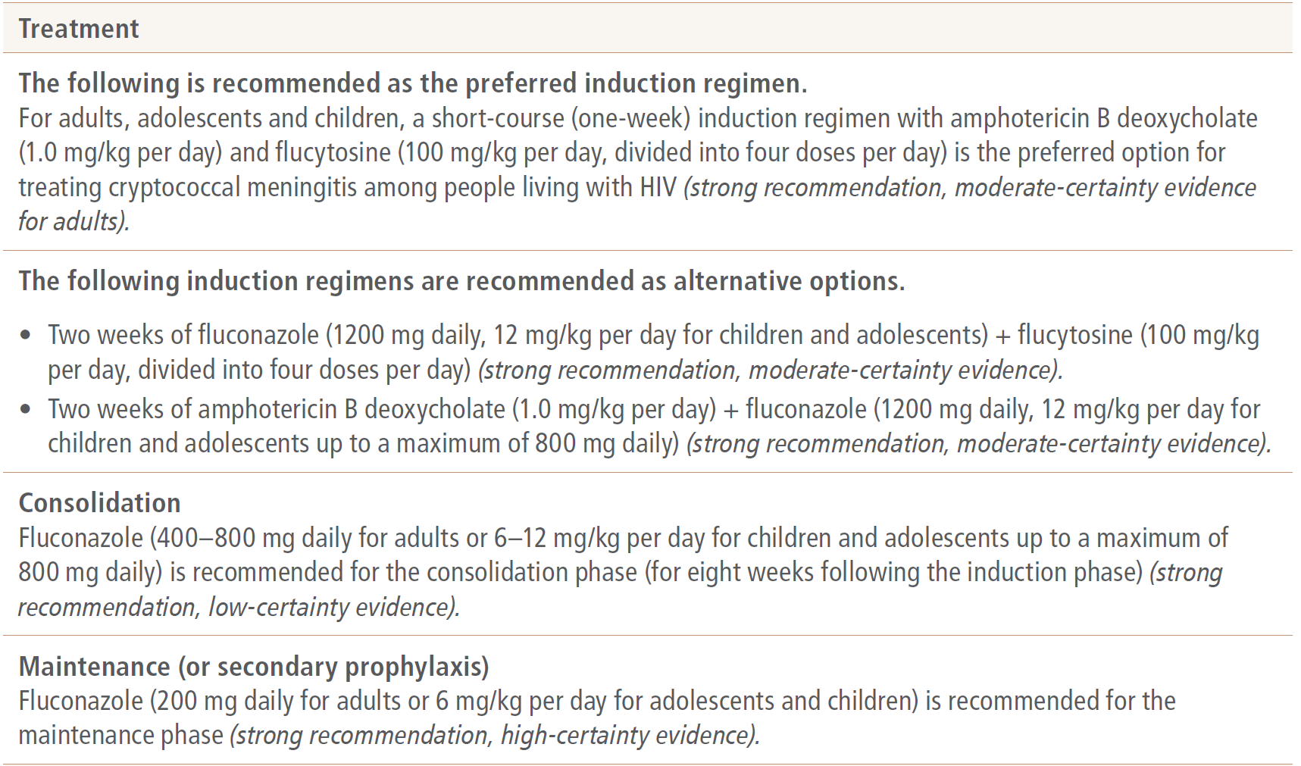
Treatment Cryptococcal Meningitis
For the most effective regimen we need
ALL THREE DRUGS
Amphotericin – ideally liposomal as less toxic
Flucytosine
Fluconazole
AMBITION trial (2021)
may lead to new guidance with a one day dose of liposomal amphotericin plus 2 weeks of flucytosine and fluconazole

Slide 12
Why we need this best treatment

Slide 13
MSF Survey 2021: 4/7 have the best regimen in guidance ( a lot updating now) None mentioning Liposomal ampho Except one – none have these drugs reliably available through MoH
 | CAR | DRC | Eswatini | Guinea | India | Kenya | Mozambique
National Guidance for Induction | No national GL | Amphotericin + flucytosine or fluconazole | Amphotericin +flucytosine | Amphotericin 2 weeks | Amphotericin + flucytosine 14 days | Amphotericin + fluconazole | Amphotericin + flucytosine ( new protocol includes L-AMB)
Amphotericin deoxylate supply free of charge through MoH | No | No | Yes | No | No | No | Yes
Flucytosine supply (where recommende) through MoH | N/A | No | Yes with MSF buffer | N/A | No | N/A | Planned for 2022
Fluconazole supplied through MoH | No | No | Yes | No | No | Yes | Yes

Slide 14
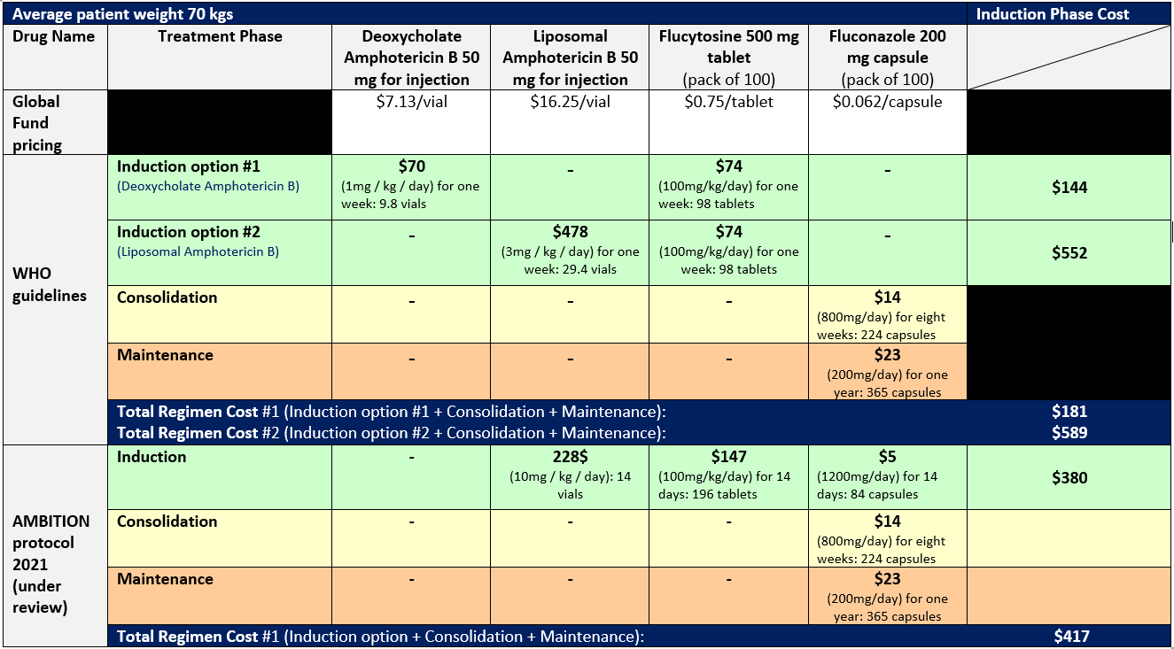
One of the reasons that WHO does not include liposomal amphotericin B (L-AmB) in its recommendations is the difficulty in procuring it and the high price – even though the liposomal formulation is less toxic (especially for the kidneys) and therefore easier to give to people needing treatment, especially in settings with limited capacity for monitoring.

Slide 15
MSF Recommendations:
Gilead and distributors must deliver on Gilead’s access programme promises
Countries should prioritize L-AmB integration in national guidelines and demand forecasting with sufficient global health funding
Generic manufacturers should consider investing in L-AmB production with larger volumes and register their products in LMICs that have high disease burden
Global health funders should prioritize funding L-AmB demands
Access Barriers to L-AmB:
Gilead’s broken promise to ensure access to L-AmB to 116 LMIC with a reduced price of $16.25/vial
Not enough countries and global demand due to:
Lack of access to diagnostic rapid tests → underestimated diagnosed cases which need L-AmB for treatment
Lack of L-AmB integration in national treatment guidelines
Limited quality-assured generic manufacturing
Misalignment of donor funding for L-AmB needs

Slide 16
FLUCYTOSINE, 500mg, tab. or cap.
Flucytosine is antifungal medicine which is used to treat serious fungal infections, such as cryptococcal meningitis – and it’s usually used in combination with other medicines.
In 2021, two new quality-assured generic sources should have become available, however one of them never got commercialized due to the low volume of global demand expressed by the small number of received orders.
Quality-assured sources of 5FC have been filed in nine sub-Saharan Africa countries where approval has been granted in one country only. In addition, two 5FC strengths have received WHO prequalification in 2021.
Globally, a handful of countries receive 5FC through pooled procurement mechanisms, such as GF, PEPFAR, CHAI, where supply to countries is supported through import waivers.
Key access barriers are lack of integration in national treatment guidelines → small volume of global demands → limited number of generic manufacturers and registration due to the small volume of demands.

Slide 17
Role of Civil Society Organizations
Civil society organizations and communities should be continuously engaged by countries, funders and WHO in all decision-making processes.
Global health funders should support HIV CSOs with funding to enable them to better hold stakeholders to account to remove access barriers to screening and treatment of cryptococcal meningitis.
Civil society organizations and communities should increase awareness, create demand, monitor availability of and access to L-AmB access at facility levels. CSOs should integrate into their advocacy work not only HIV, but also advanced HIV disease, cryptococcal meningitis and access barriers to WHO-recommended treatments including L-AmB and flucytosine.

Slide 18
Has Cryptococcal Meningitis made it onto the global priority agenda?
Targets – if we are not measuring it how do we know we are doing it
Not in UNAIDS strategy
Not in UNHLM text
Mentioned in PEPFAR COP2022
Included in GF technical note
Opportunity for new WHO strategy
https://msfaccess.org/sites/default/files/2021-05/Cryptococcal%20Meningitis_Briefing_Doc-END_CM%20DEATHS_2030-strategic%20framework_ENG_14.5.2021.pdf

